Slide 1
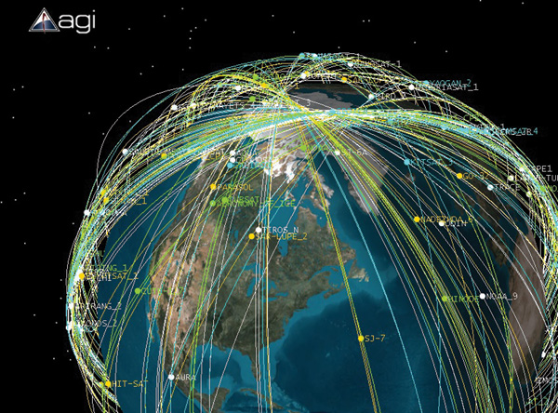
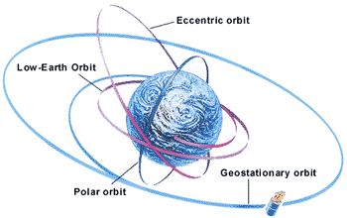
Astrodynamics & Mission Geometry

Slide 2
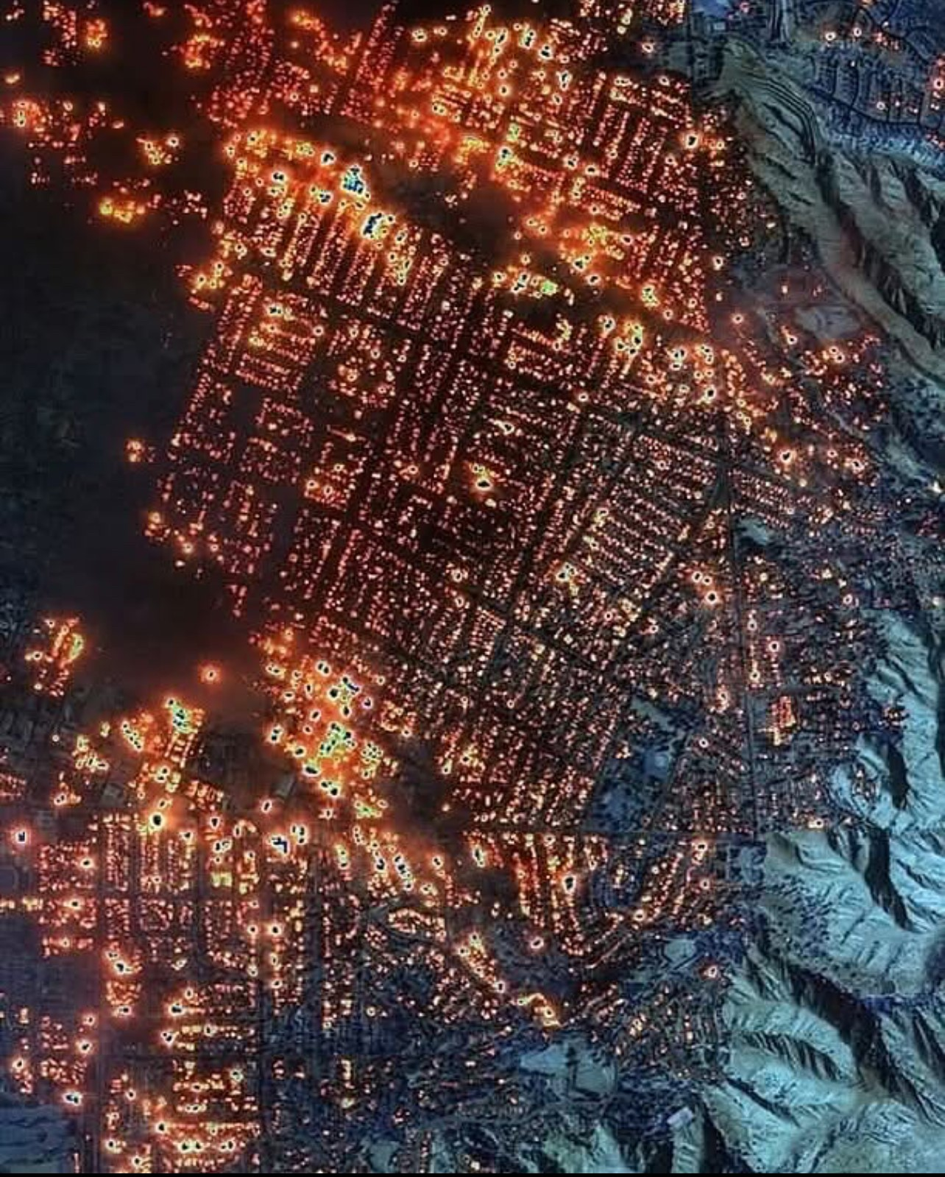

Slide 3
Mission Planning
Transfer from Parking Orbit to Mission Orbit
Station Keeping
Drag
J2
3rd Bodies
Solar Radiation Pressure
Pointing Requirements
End of Life

Slide 4
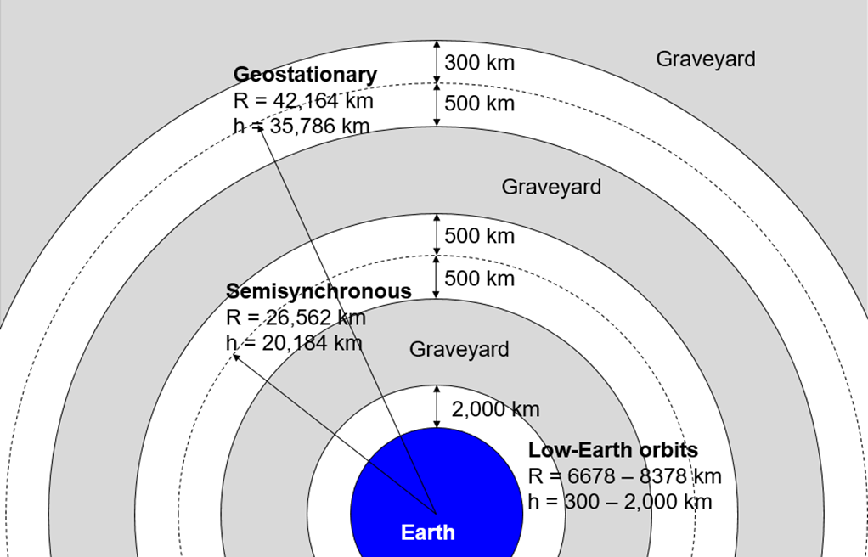
Mission Orbits

Slide 5

2 Body Equation Of Motion
$$R=\frac{a(1−e^{2})}{1+e Cos ν}$$

Slide 6
Perturbations
a minor deviation in the course of a celestial body, caused by the gravitational attraction of a neighboring body.
Drag
Causes Spacecraft to Re-Enter
Changes orbit size and shape (a & e)
J2
Right Ascension changes – Sun Synch (98 deg)
Argument of Perigee changes – Molnyia (63.4 deg)

Slide 7
Perturbations
Secular (non-periodic)
Asymptotic
Exponential
Linear
Step
Periodic
Long-period
Short-period

Slide 8
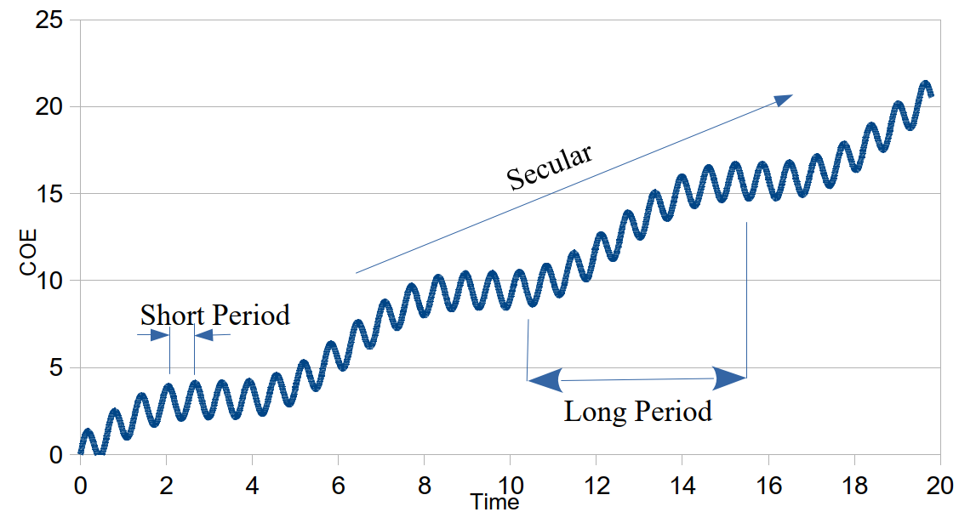
Perturbations

Slide 9
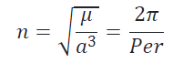
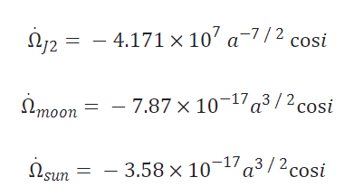
Perturbation Equations
Number of orbits per day (n)
RAAN
rates in rad/s, distances in km

Slide 10
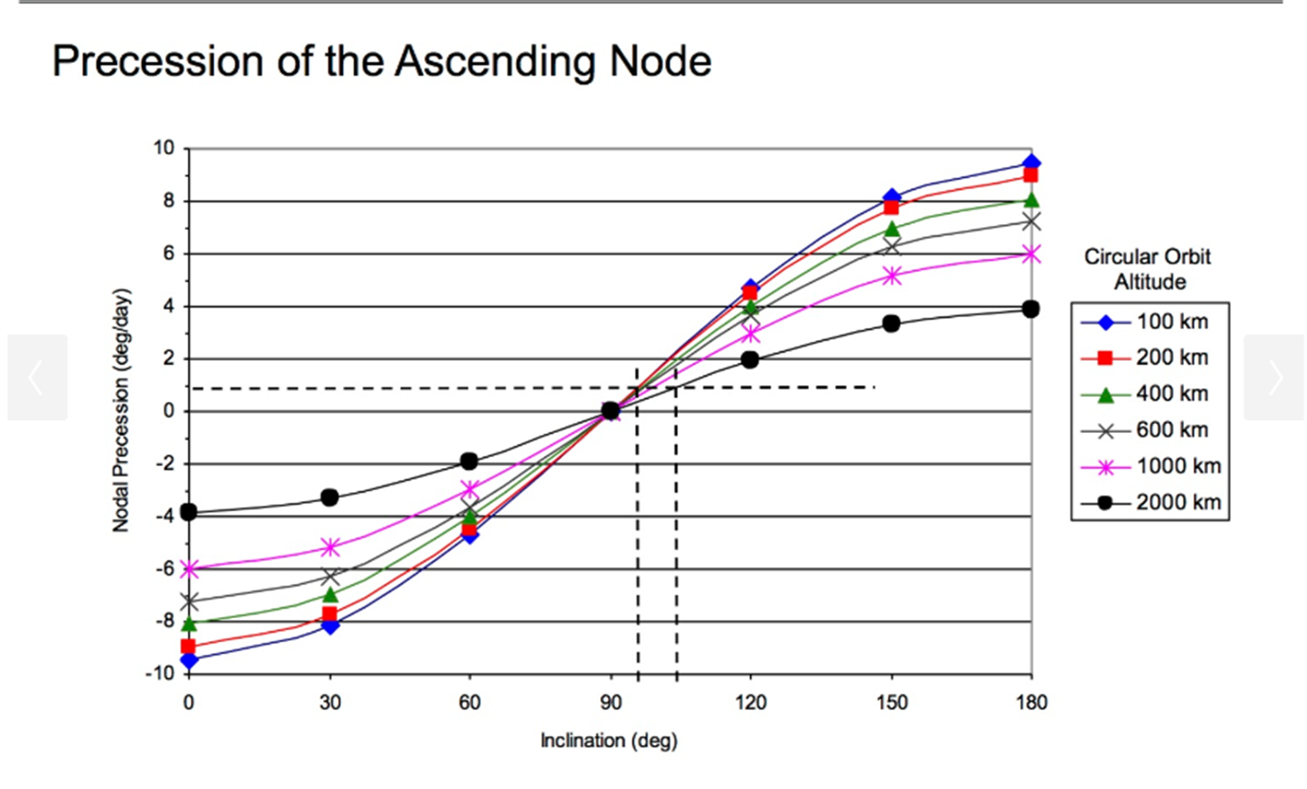
RAAN

Slide 11
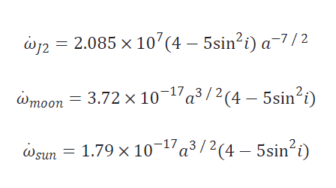
Perturbation Equations
Argument of Perigee

Slide 12
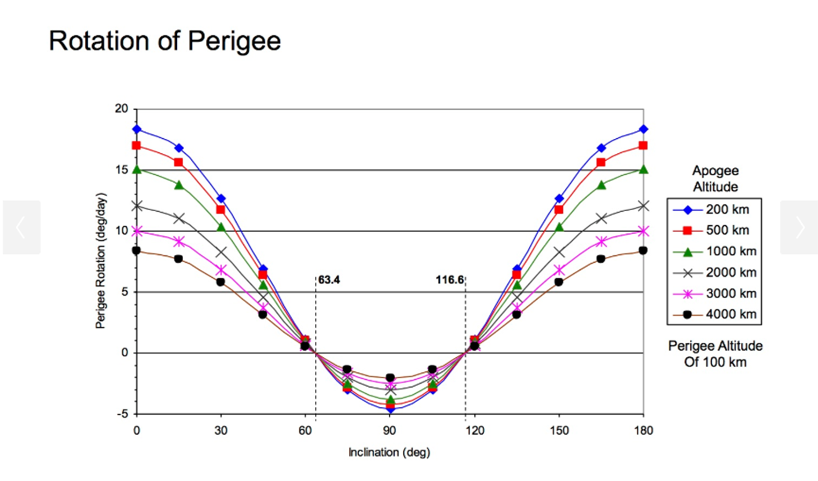
Argument of Perigee

Slide 13
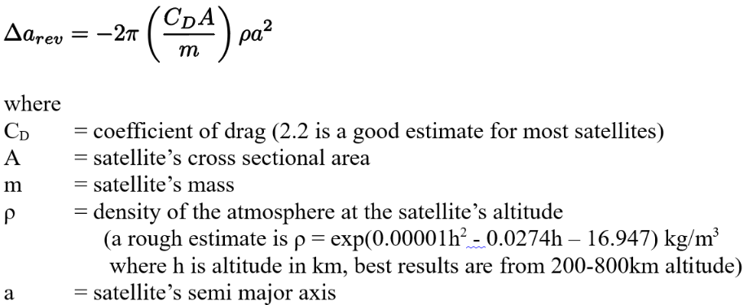
Drag
Based on Ballistic Coefficent

Slide 14
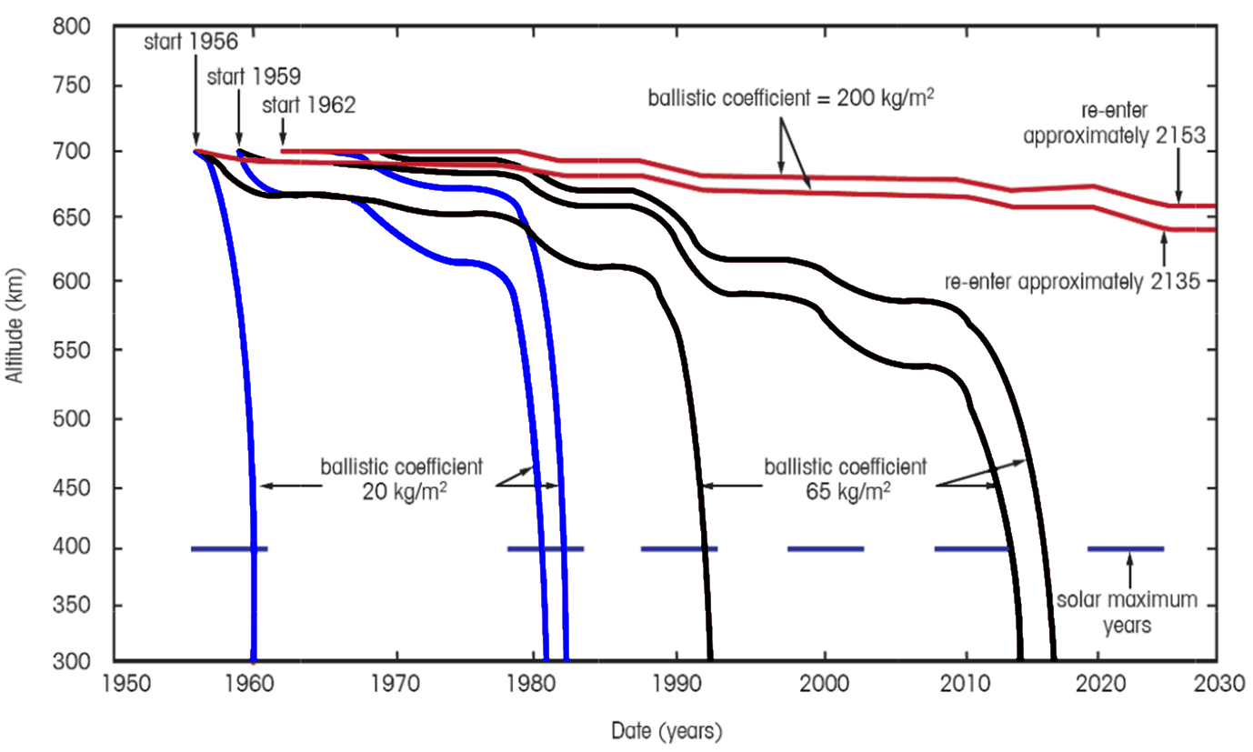
Drag

Slide 15
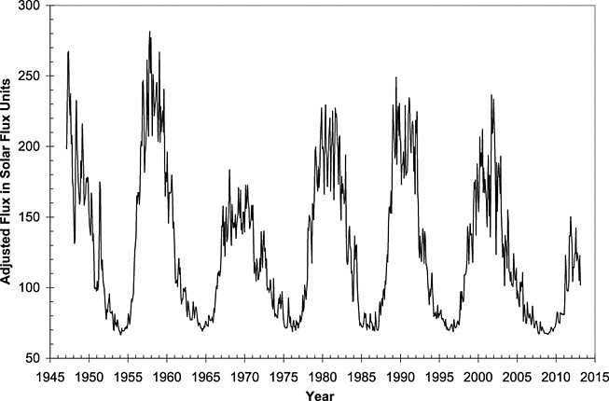
Solar Cycle

Slide 16
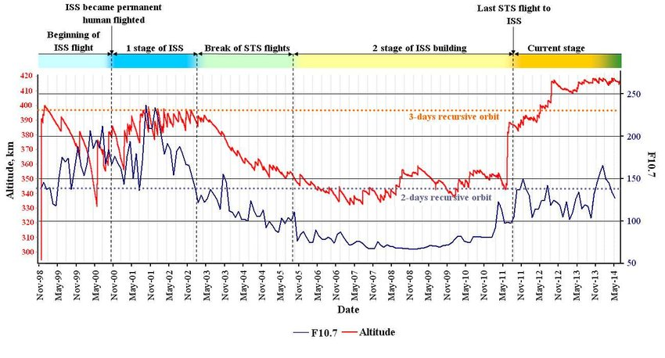
ISS

Slide 17
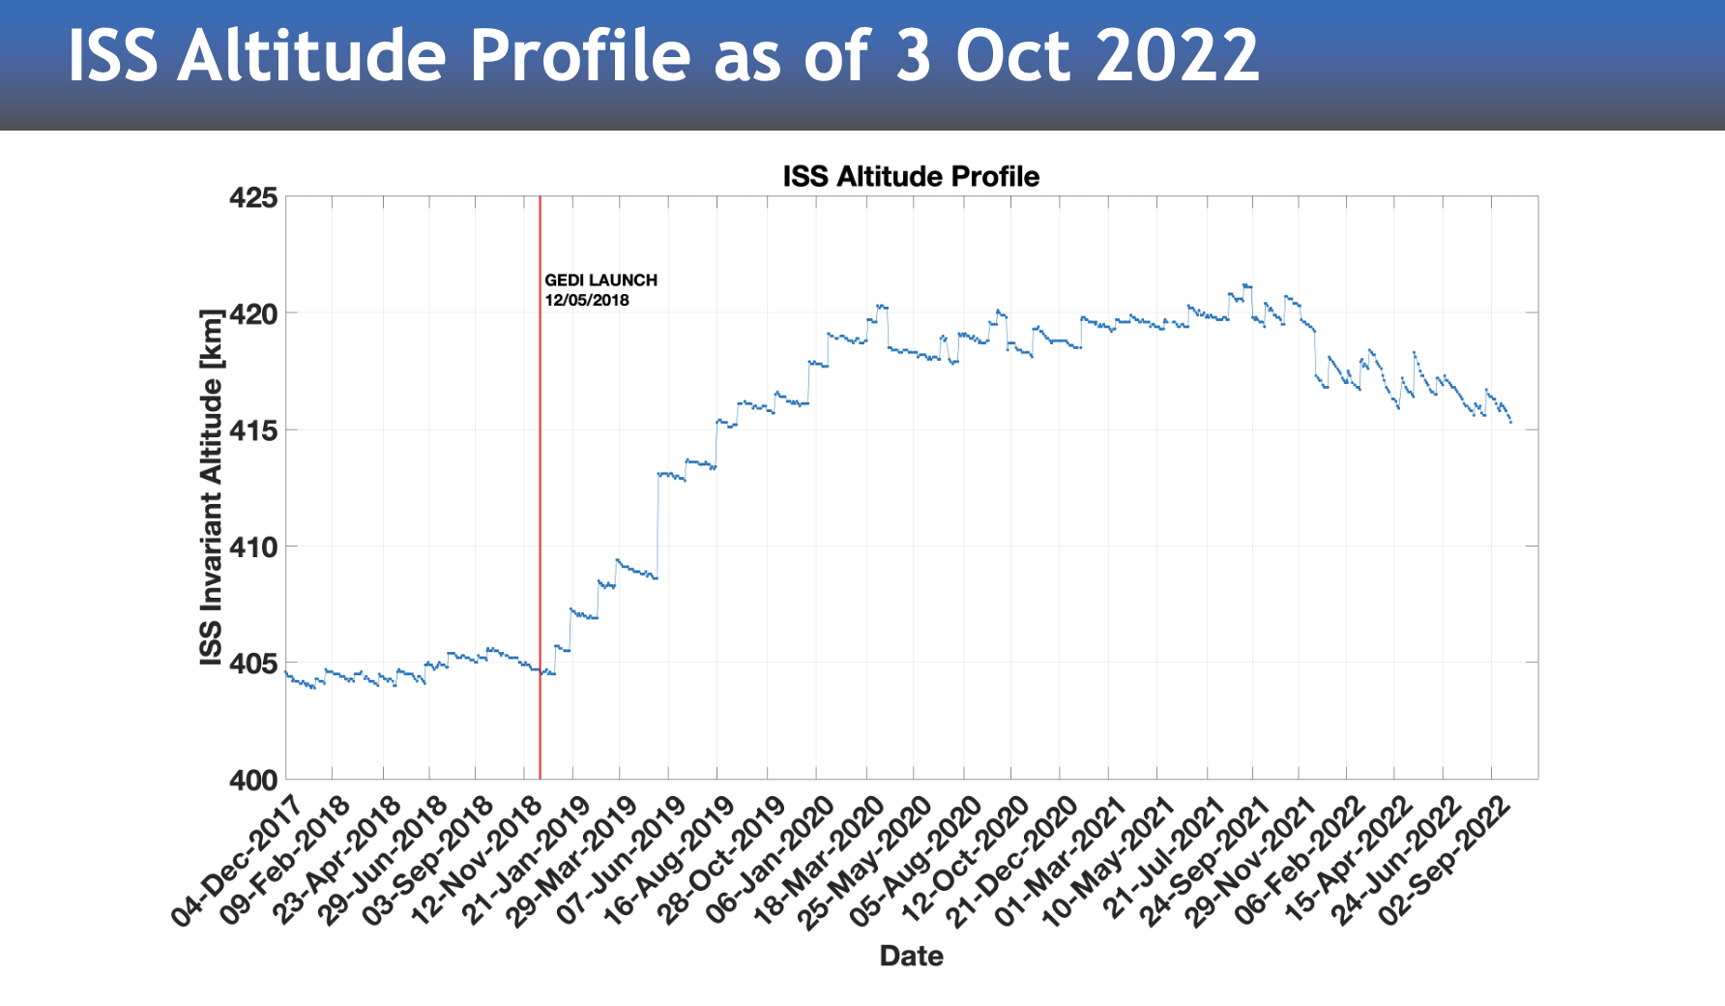
ISS
Cygnus

Slide 18
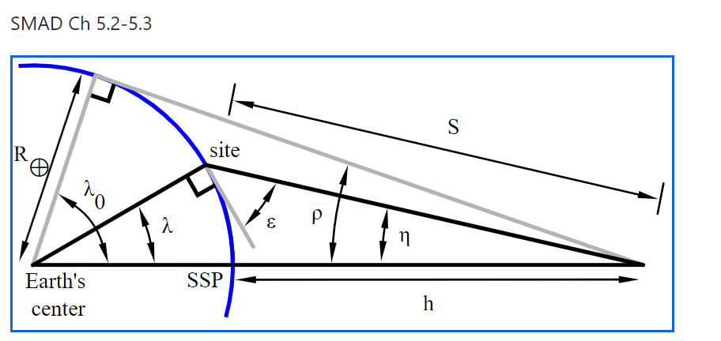
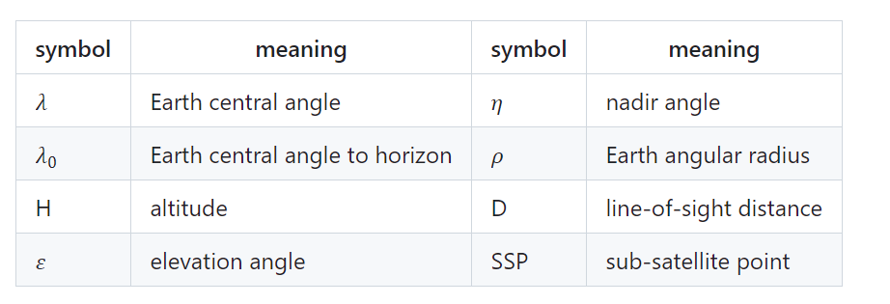
Geometry
S
S

Slide 19
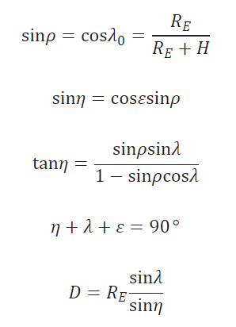
Geometry
S

Slide 20


In View
Max pass time
Rules of Thumb
Average Pass = 80% of Tmax
86% of passes will be longer than Tmax/2

Slide 21
Constellation
Depends on your mission
Revisit rate (Planet: 14/day)
Max gap (SMAD: FireSat)
Spacecraft in view (GPS >4)
% coverage
Proliferated Constellations

Slide 22
Example
If a future FalconSat is at circular orbit of 400km altitude with an inclination of 51.7 degrees, what is the estimated maximum pass time?

